Slide 1
Research on similar games and their mechanics
Ionut Ciobanu
Group 7

Slide 2
‘Brawlhalla’
Competitive action platformer game
Fast paced
Skill based
Fighting is the main mechanic (main focus of the game)
High variety of moves to master
Learn-practice-master loop
Winner is the most skilled always
Little to no luck involved

Slide 3
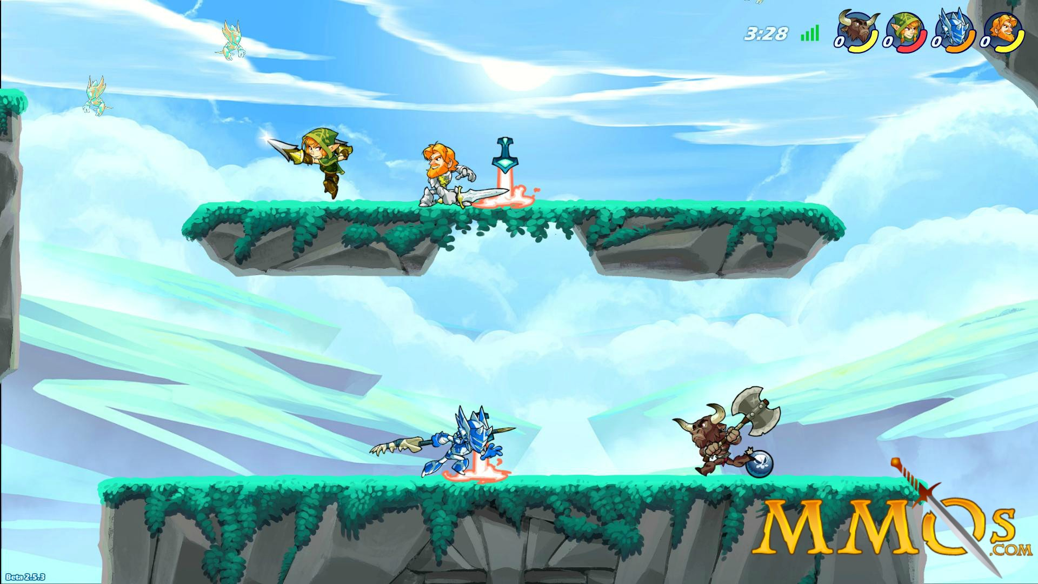
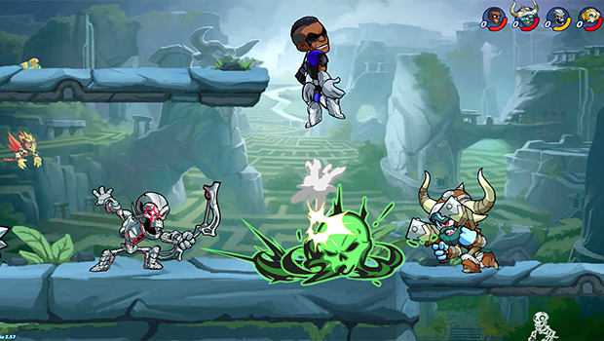

Slide 4
‘Brawlhalla’
Only luck element I managed to identify in the game is the ‘random’ weapon drop system, where one of the 2 available weapons for each hero drops on a random spot at a random time.
You’re ‘lucky’ if the weapon that just dropped is the one you know better – mastered.
The fights are always really fast paced and chaos ensues when there are more than 4 players fighting.
Game is organised in rounds in duels (1v1) – the first to K.O. his opponent 3 times wins. Each K.O. represents a round.
Camera pans IN and OUT when necessary.

Slide 5
‘Towerfall’
Local multiplayer platform brawler
Fast paced
Skill based
Fighting using weapons is the main focus
High variety of moving options
Various ammo types
Finite ammo mechanic (collect shot arrows to reload)
Random treasures that drop ammo types
Random events that increase difficulty

Slide 6
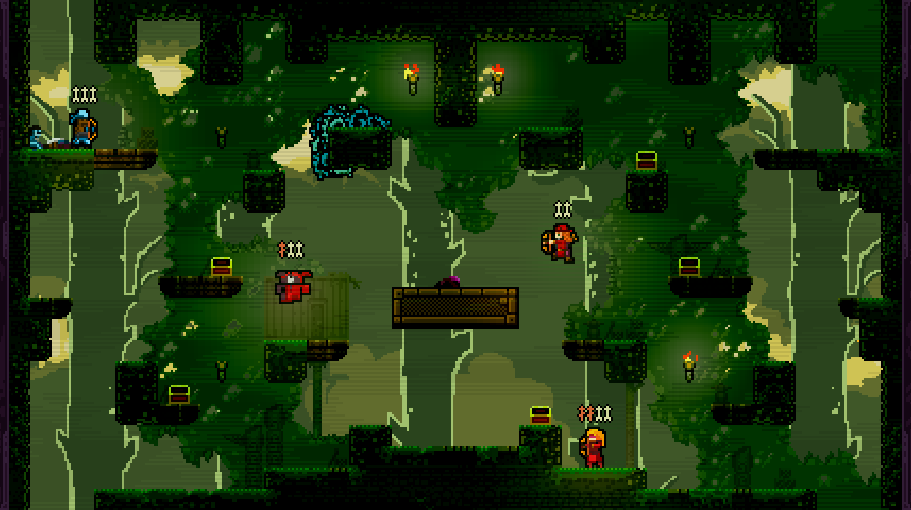
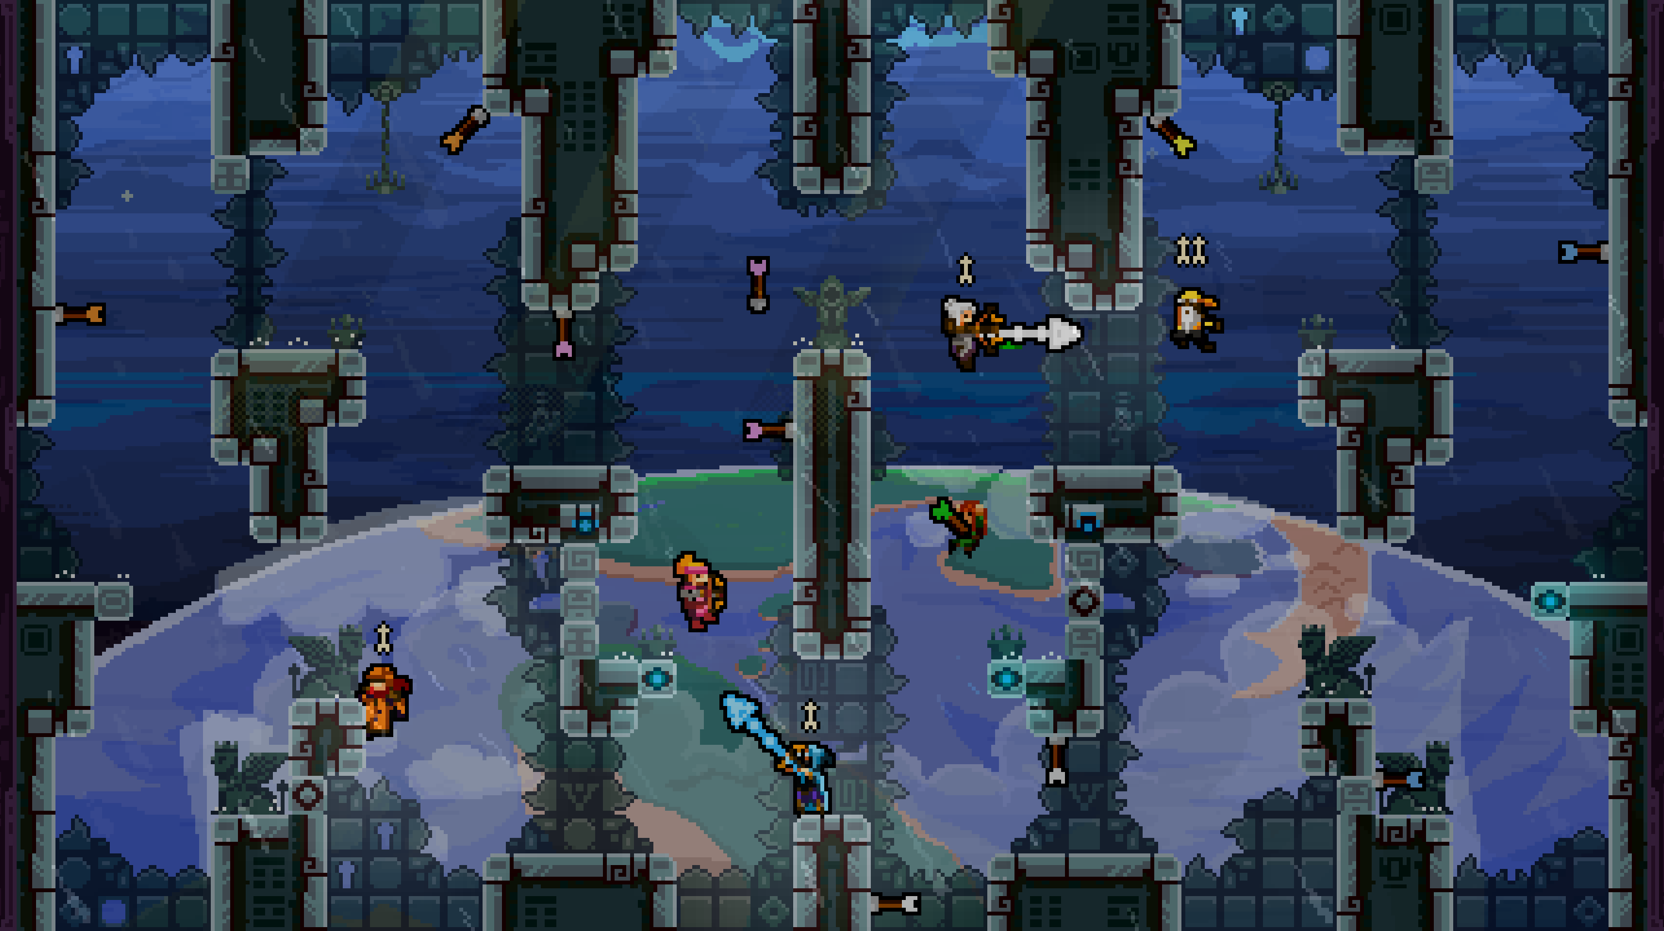

Slide 7
‘Towerfall’
In this game the mechanic I liked the most is the ‘random event’ one, where the screens starts morphing thus making things harder to see, increasing difficulty for the players. They do know when the event is going to happen, but the timeframe left to prepare is always slim.
‘Random’ events, relatively slim timeframe left to prepare.
Players are never punished for doing good, but they are for being not skilled enough.

Slide 8
‘Speedrunners’
Progressively faster paced
Competitive racing type platformer
No random elements
No mechanics involving luck
Players have equal chances
Skill based
Simple art style, GAMEPLAY is the focus
Power-ups / abilities available – scattered around the map BUT always in the same place.
Camera follows players
Timed rounds

Slide 9
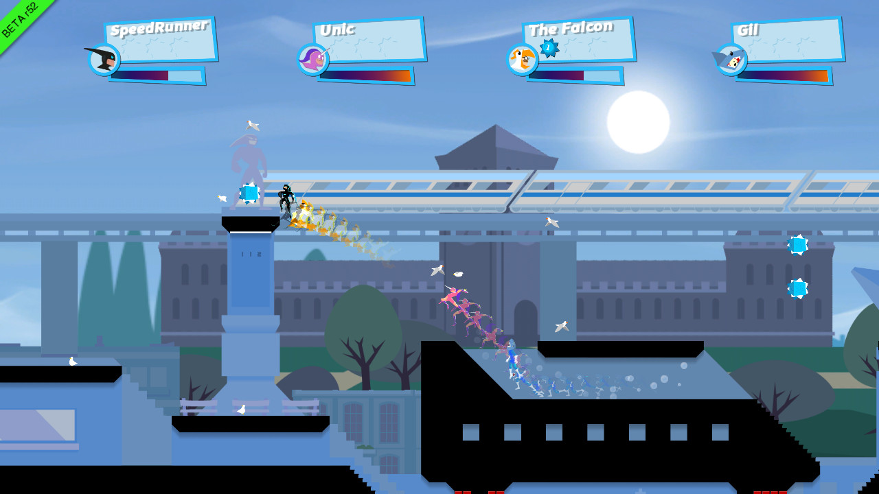

Slide 10
‘Speedrunners’
Minimalist art style – gameplay is the focus, nobody stops in place to admire the platforms or the background.
The shrinking screen ‘time left’ mechanic is extremely interesting and can lead to tension and fun moments between the players.
No luck involved, all skill based mechanics. The most skilled player wins.

